Slide 1
Code Review Training Course. Part 5: Web Services
For VIB only
namhabach@gmail.com

Slide 2
Outline
1
Web Services
2
Web Services Risk
3
SOAP in Action
4
Securing SOAP
5
Code Review

Slide 3
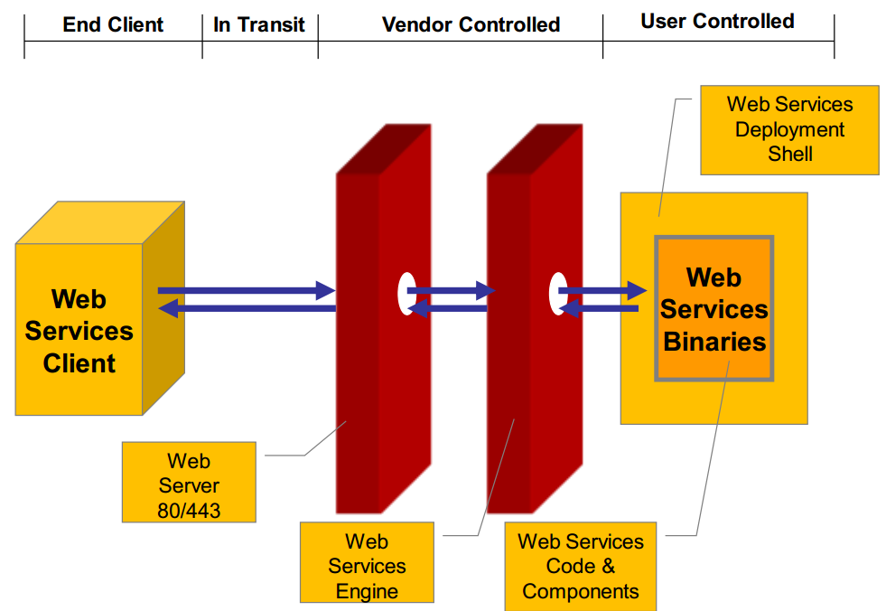
Web Services

Slide 4
Web Services Risk

Slide 5
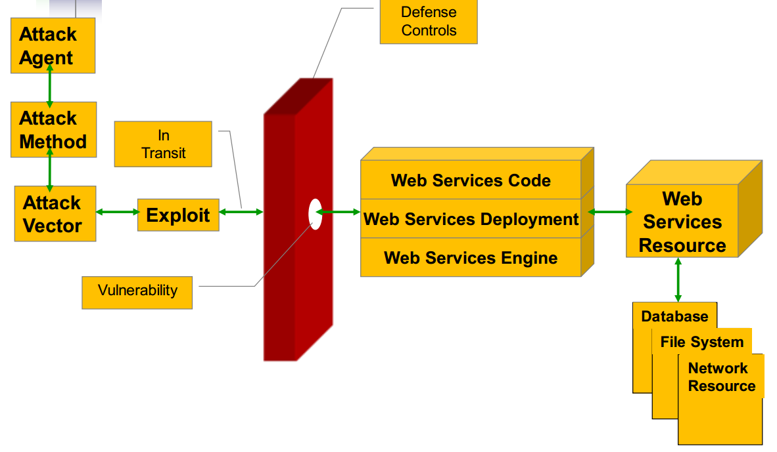

Slide 6
Risk - In transit
In transit Sniffing or Spoofing
WS-Routing security concern
Replay attacks

Slide 7
Risk - Web services Engine
Buffer overflow
XML parsing attacks
Spoiling Schema
Complex or Recursive structure as payload
Denial of services
Large payload

Slide 8
Web services Deployment - Risk
Fault code leaks
Permissions & Access issues
Poor policies
Customized error leakage
Authentication and Certification

Slide 9
Web services User code - Risk
Parameter tampering
WSDL probing
SQL/LDAP/XPATH/OS command injection
Virus/Spyware/Malware injection
Bruteforce
Data type mismatch
Content spoofing
Session tampering
Format string
Information leakage
Authorization
We Are Here ???

Slide 10
SOAP in Action

Slide 11
SOAP?
Simple Object Access Protocol
Invoking objects on remote machine
I/O with remote objects
It is XML-based messaging
Works over HTTP/HTTPS and on few other protocols
That is why firewall cannot block them.
Attacks are easy and possible.

Slide 12
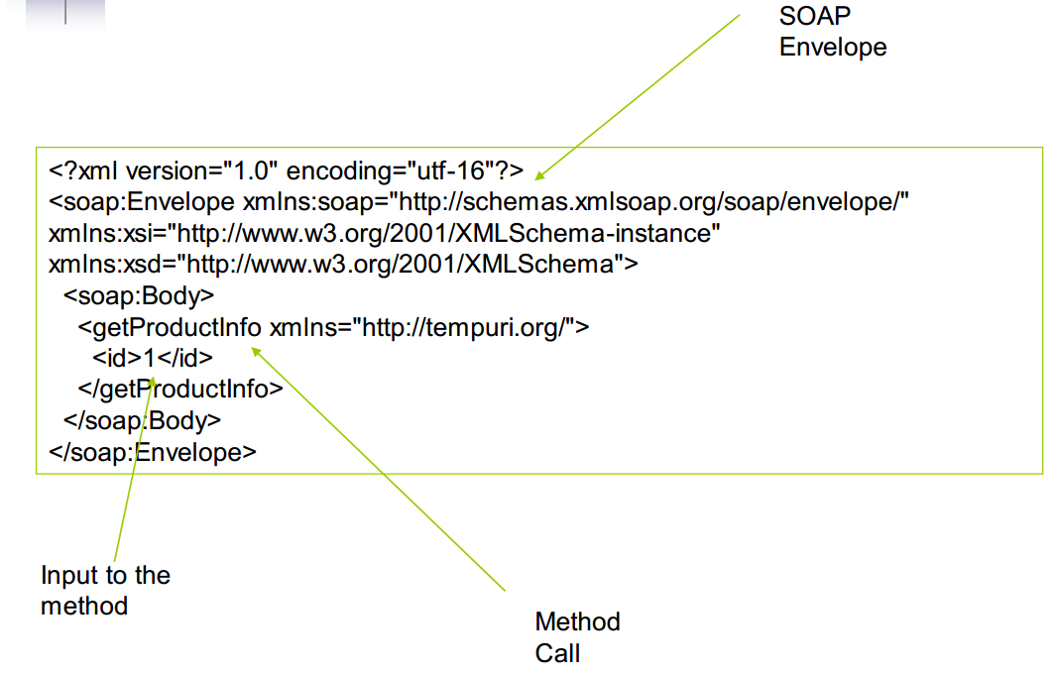
SOAP request

Slide 13
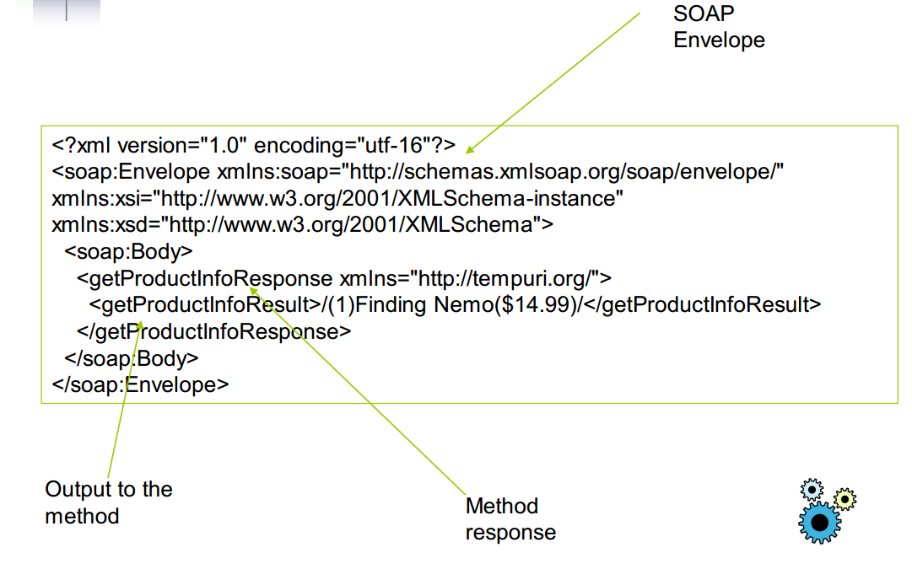
SOAP response

Slide 14
AV 1 - XML poisoning
• XML node manipulation
• Attack on parsing logic
SAX
DOM
Can be lethal – DoS or breaking execution logic

Slide 15
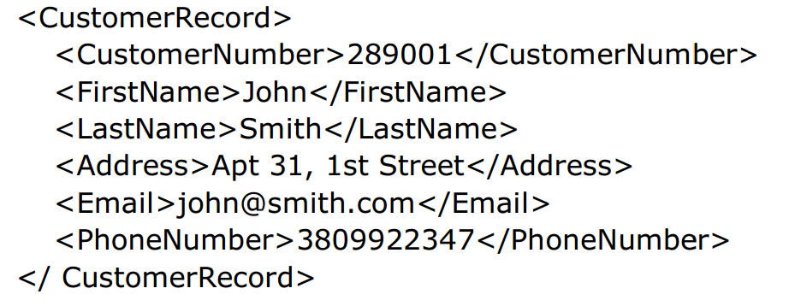
XML poisoning

Slide 16
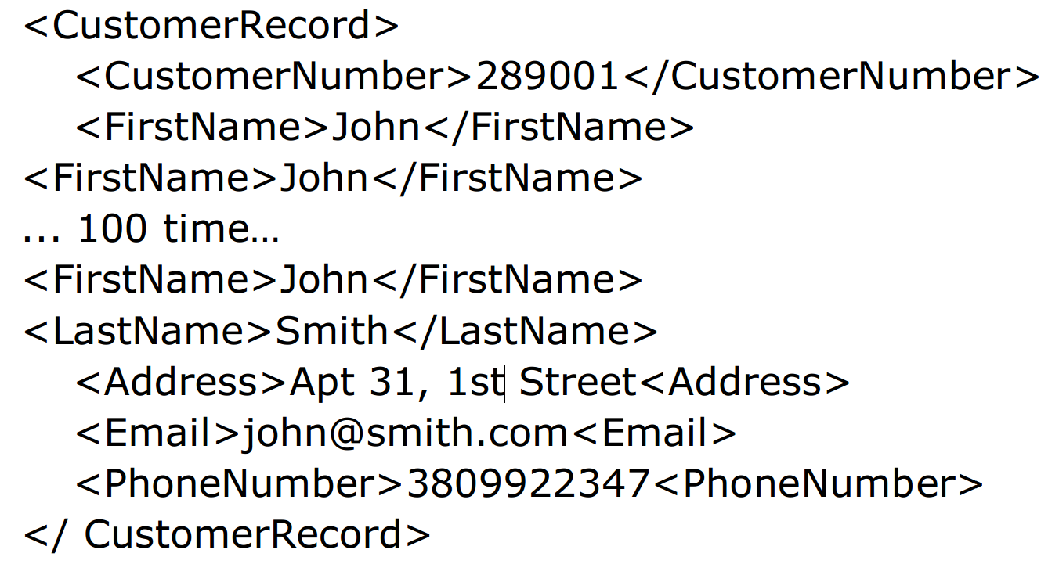
XML poisoning

Slide 17
Parameter tampering & Fault code leakage
Fault code of web services spit lot of information about internal workings.
This attack can fetch internal paths, database interfaces etc.
Fault code is part of SOAP envelope and this helps an attacker to make logical deduction about assets.

Slide 18
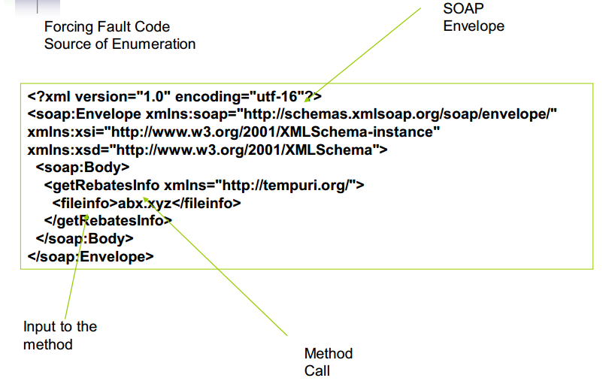
SOAP request

Slide 19
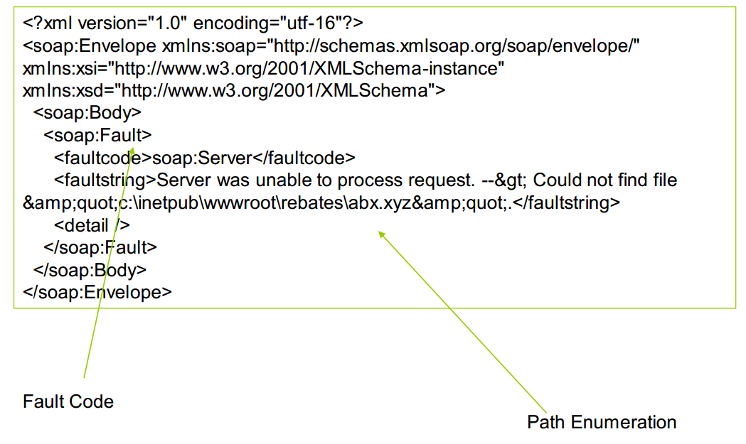
SOAP response

Slide 20
AV 3 - SQL injection
SQL injection can be done using SOAP traffic.
It is innovative way of identifying database interface points.
One can leverage xp_cmdshell via SOAP.
Back end database can be compromised using this attack.

Slide 21
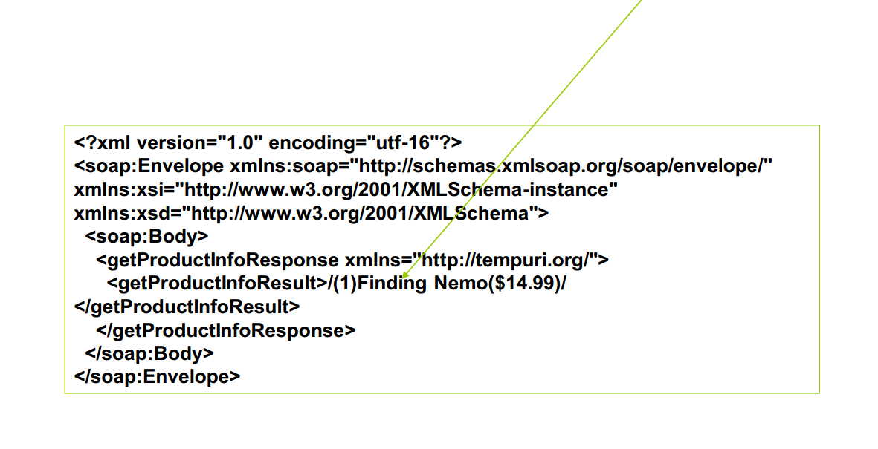
SOAP request

Slide 22
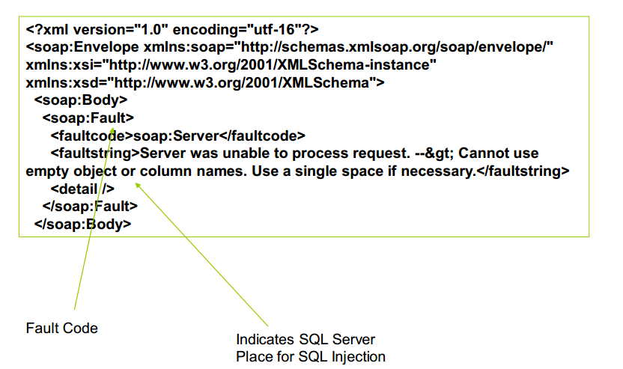
SOAP response

Slide 23
AV 4 – XPATH injection
XPATH is new way of querying XML documents.
This attack works nicely on web services since they use XML extensively.
Developer’s loophole can be leveraged with an exploit.
XPATH query crafting is next generation attack methods.

Slide 24
XPATH Injection - Basics
XPATH is a language defined to find information from
XML document.
As XPATH name suggests it indeed uses path to traverse through nodes of XML document and look for specific information from the document.
XPATH provides expressions like slash (/), double slash (//), dot(.), double dot (..), @, =, <, > etc. It helps in traversing through XML document.

Slide 25
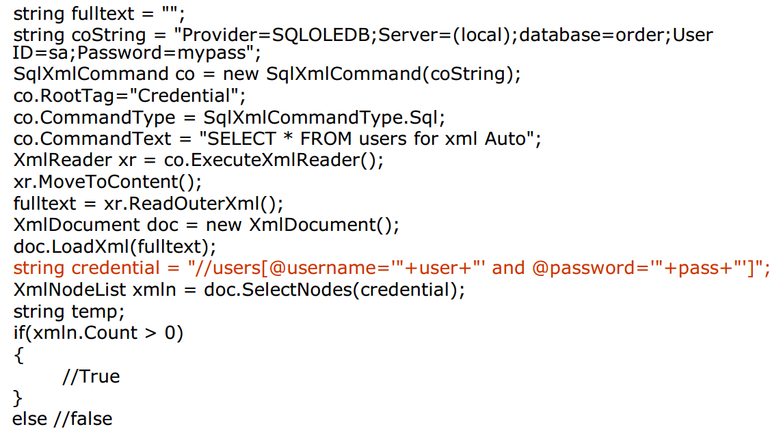
XPATH – Vulnerable Code

Slide 26
AV 6 – LDAP injection
LDAP authentication in place
Possible to manipulate LDAP queries
May leads to enumeration OR manipulation
Interesting attack vector
Fault code leaks LDAP interface

Slide 27
AV 7 – File System access
Identifying file system points
Directory traversing & Access
Leads to file access and source code exposure
Lethal if found!

Slide 28
AV 7 – SOAP brute forcing
SOAP envelope takes user & pass accounts.
It is possible to bruteforce SOAP envelope and look for specific responses.
This is a possible attack which can get into the system.
Analyzing SOAP response is key for this set of attack.

Slide 29
AV 8 – Parameter overflow
Adding large buffers to XML nodes
Depending on code controls – It may fail in handling
Breaking the application
May compromise as well
Traditional buffer overflow type attacks

Slide 30
AV 9 – Operating System access
Point to OS
Remote command execution is possible
Either by “|” or “;”
Attack is very much possible
Leads to admin/root on the box…

Slide 31
AV 10 – Session hijacking
Web services can maintain sessions
[WebMethod(EnableSession=true)]
Possible to reverse engineer session
Cookie tempering is reality…
Can be compared to traditional web application session.

Slide 32
Other attacks
External referencing – XML schema
XSS attack
In transit attacks – replay and spoofing

Slide 33
Securing SOA

Slide 34
SOAP filtering
Regular firewall will not work
Content filtering on HTTP will not work either since it is SOAP over HTTP/HTTPS
SOAP level filtering and monitoring would require
ISAPI level filtering is essential
SOAP content filtering – products or in-house

Slide 35
WSDL hardening
WSDL is major source of information
Should not have any leakage
Only provide necessary methods
Invokes over SSL only
WSDL hardening thoroughly

Slide 36
Authentication & Authorization
WSDL access control
Use of SAML
Credentials – WS-Security
Certificate analysis
SOAP and XML filtering before access

Slide 37
Secure Coding
Fault code management and Exception control
Input validation
SQL integration
Levels of coding using different components

Slide 38
XML parsing
Good XML parsing should be used
.Net/J2EE – may have issues with XML parsing
Buffer overflows using schema poisoning

Slide 39
Code Review

Slide 40
Methodologies
Same as Web Application Code Review
Add More:
Authentication
Session Manager
Access Control (Authorization)
Don`t use same account for webservices
Disable XML External Entity

Slide 41
Authentication
Use username/password to Authentication with Web Services
Web Service Stateless
Web Service Stateful
Username is unique
Limit Access
By IP Address

Slide 42
Session Manager (Web services stateful)
Token generate
Long
Random
Can not predict
Use safe lib: CVE detail, Exploit-DB…
SecureRandom prng = SecureRandom.getInstance("SHA1PRNG");
String randomNum = new Integer(prng.nextInt()).toString();
MessageDigest sha = MessageDigest.getInstance("SHA-1");
byte[] bytes = sha.digest(randomNum.getBytes());
String session_token = new BASE64Encoder().encode(bytes);

Slide 43
Session Manager (Web services stateful)
Use Token Security
Don`t sent via URL
HTTP Cookies
SOAP Message
Token timeout
Logout function

Slide 44
Access Control
User permission
By Function
By Data Access
Same as Web Application
Don`t use same Web Services Account

Slide 45
Disable XML External Entity
Disable XML External Entity (XXE) in XML Parsing
Java
JAXP DocumentBuilderFactory & SAXParserFactory
StAX & XMLInputFactory
DocumentBuilderFactory dbf = DocumentBuilderFactory.newInstance();
FEATURE = "http://xml.org/sax/features/external-parameter-entities";
dbf.setFeature(FEATURE, false);
dbf.setXIncludeAware(false);
dbf.setExpandEntityReferences(false);
xmlInputFactory.setProperty(XMLInputFactory.SUPPORT_DTD, false);

Slide 46
Disable XML External Entity
ASP.NET 3.5
Lib XmlTextReader
Lib XmlReader
ASP.NET 4.0
XmlReader
XmlTextReader reader = new XmlTextReader(stream);
reader.ProhibitDtd = true;
XmlReaderSettings settings = new XmlReaderSettings();
settings.ProhibitDtd = true;
XmlReader reader = XmlReader.Create(stream, settings);
XmlReaderSettings settings = new XmlReaderSettings();
settings.DtdProcessing = DtdProcessing.Prohibit;
XmlReader reader = XmlReader.Create(stream, settings);

Slide 47
Questions?

Slide 48
Exercise

Slide 49
#Enter to next part_>
End of Part 5

